Slide 1
Strategic Leadership
Prof. Peter Mayer
Inputs into our discussion on good leadership in vocational training schools

Slide 2
What is Leadership?
Leadership is the process of influencing an organisation (or group within an organisation) in its efforts towards achieving an aim or goal

Slide 3
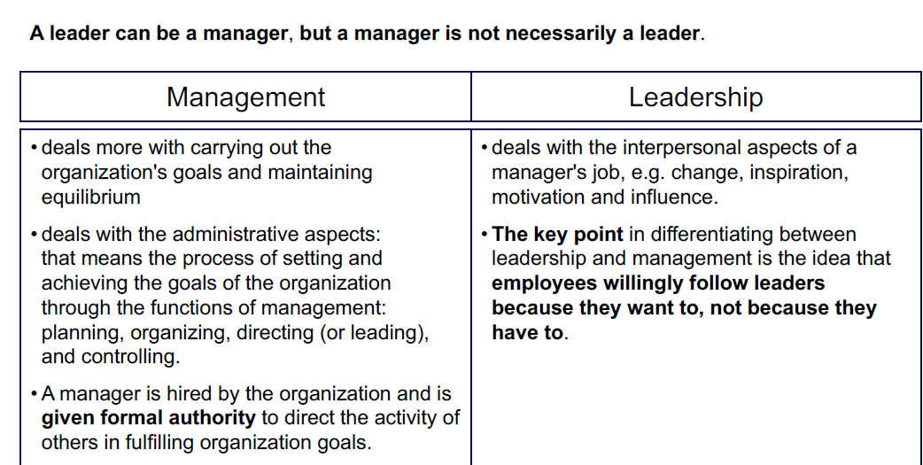
Management and Leadership

Slide 4
Management and Leadership
Sometimes we differentiate between MANAGEMENT and LEADERSHIP.
MANAGEMENT refers to the carrying out administrative tasks
LEADERSHIP deals with interpersonal aspects, with inspiration, motivation and change.

Slide 5
Strategic Leadership
We like to talk about STRATEGIC leadership. However, the word “strategic” often does not mean much.
The term gains meaning when we see STRATEGY as the positioning of an organisation in relation and a response to others’ actions.
The implication of such an understanding makes clear that STRATEGIC LEADERSHIP requires observing what others do: Competitive intelligence is the act of collecting and analyzing information about competitors and the marketplace

Slide 6
Styles of leadership
Visionary — mobilize people toward a vision. Works best when a clear direction or change is needed. Creates a positive climate.
Coaching — develop people for the future. Works best when helping people and building long-term strength. Creates a positive climate.
Affiliative — create emotional bonds and harmony. Works best to heal rifts in teams or motivate people in stressful times. Positive climate.
Democratic — build consensus through participation. Works best to create consensus or get input. Creates a positive climate.
Pacesetting — expect excellence and self-direction. Works best to get quick results from a highly competent team. Negative climate.
Commanding — demand immediate compliance. Works best in crisis or with problematic people. Creates a negative climate

Slide 7
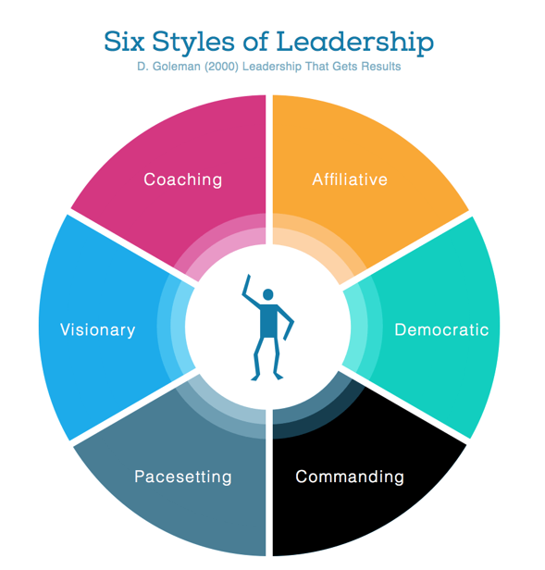

Slide 8
Factors which influence the leadership style
Age of the leader
Development level of the leader
Personal value system of the leader and character
Confidence in individuals and teams
Type and nature of task (e.g. what kind of change; time at your disposal) – situational leadership
Maturity of the followers and team members
Stage in a change process
Culture (of an organization, of a discipline, of a nation)

Slide 9
Leadership style and context
A leadership style must be in line with the person who leads.
The best leadership style depends on the task
And it depends on the followers of the leader, the colleagues, team members and subordinates

Slide 10
Situational leadership – the followers matter
The most effective LEADERSHIP STYLE depends to some extent on the experience and maturity of the followers.
When the followers have little experience, then TELLING and DIRECTING might be good. When they have some competence, then COACHING is possibly appropriate. When the have high competence, then SUPPORTING is required. When they are very highly motivated and committed, then DELEGATION might be best.

Slide 11
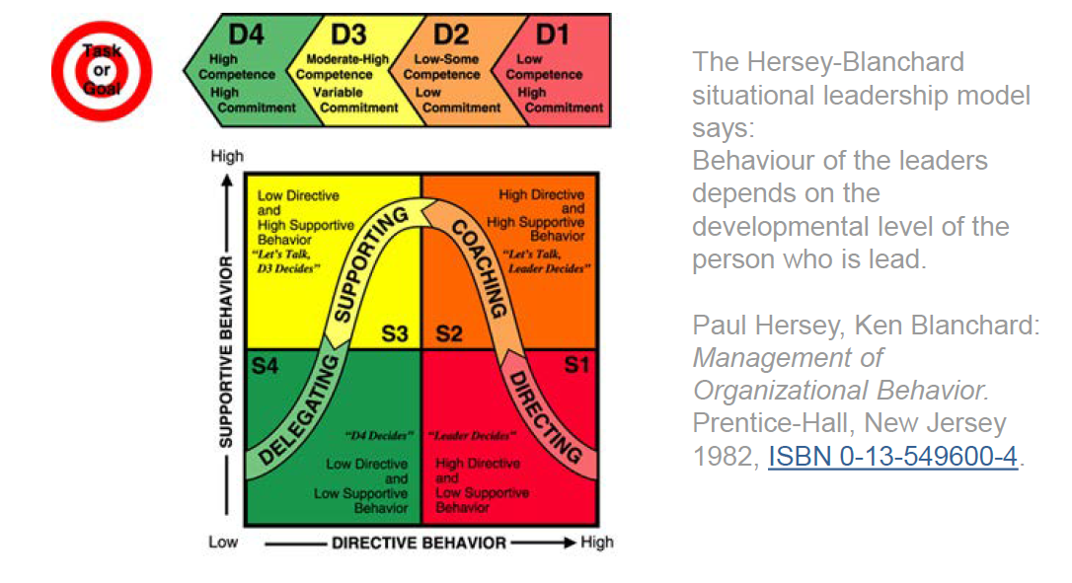
Situational leadership

Slide 12
Leadership and aims
Good leadership requires a sound understanding of the aims/ goals of an organisation.
Which aims do we have? Is it the number of students, the budget, the number of employees, the market share, the successful accreditation the relevant aim?
And how do we include the long-term and the uncertainty in our analysis.
We have many goals/ aims. And there are trade-offs. This should always be kept in mind.

Slide 13
Leadership and limits of our rationality
Leadership requires showing determination. However, we often overestimate our capacity to reason and decide objectively. Daniel Kahneman, the nobel laureate, showed how easily we err.
Decision making calls for sound weighing of arguments.
It requires reflecting on issues from various perspectives (six thinking hats).
It calls for considering stakeholders (stakeholder analysis)
and possibly visualizing stakeholders, SWOT etc.

Slide 14
Leadership implies setting priorities with respect to the leader’s time
We typically have limited time and a great number of tasks. So we need to decide which issues are dealt with first.
The Pareto-Rule or Pareto-Principle states that about 80 percent of the consequences come from 20 percent of the causes.

Slide 15
Leadership requires communication
There are many methods. The choice of the method depends on the context:
  Personal talk
  Phone calls
  Meetings (regular or irregular)
  E-Mail to groups
  Reports
  Newsletter
  Etc.

Slide 16
Leadership style and the level of involvement
Style | Means / context | Benefits | Problems
Education | Group briefings assume internalisation of strategic logic and trust of top management | Overcoming lack of information | Time consuming
Participation | Involvement in setting the strategy agenda and or resolving | Increasing ownership | Time consuming
Intervention | Change agent retains co-ordination | Process is guided | Risk of perceived manipulation
Direction | Use of authority | Clarity and speed | Risk of lack of acceptance
Coercion | Explicit use of power through edict | May be successful in crises | Least successful unless crisis

Slide 17
Leadership – formal authority and personal authority
By holding a position, we just have the FORMAL AUTHORITY. This enables the leader to take decisions.
The PERSONAL AUTHORITY is gained through the personality, or achievements, through behaviour, through good communication. This is important for the perception of your actions.
To rely only on the formal authority is not wise, is not good leadership.

Slide 18
Thank you very much for your attention

