Slide 1
Project Management:
Project Action Plan (PAP)
Muhammad Ihsan Zul
December 9, 2021

Slide 2
Project Action Plan Structure
Project Action Plan Content

Slide 3
General Information
Project Title
Country
Name (your name)
Institution
Position
Project Team (your team)
Objectives
Expected Learning Outcomes

Slide 4
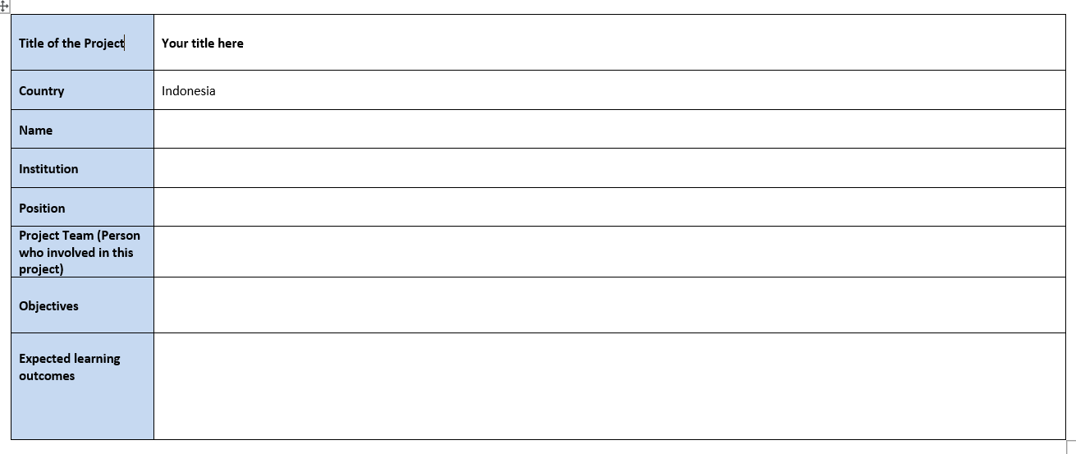
All person involved to this project
The objectives of the project

Slide 5
Main Task, Task and Milestone
Main Task: a piece of work which you have to do, usually as part of a larger project. The main task consists of small tasks arranged to complete the main task
Task: as a part of main task, with clear activities, person, duration, resources and material, output and potential risk
Milestone: a specific point within a project’s life cycle used to measure the progress toward the final goal. Milestone break the project into phases.

Slide 6
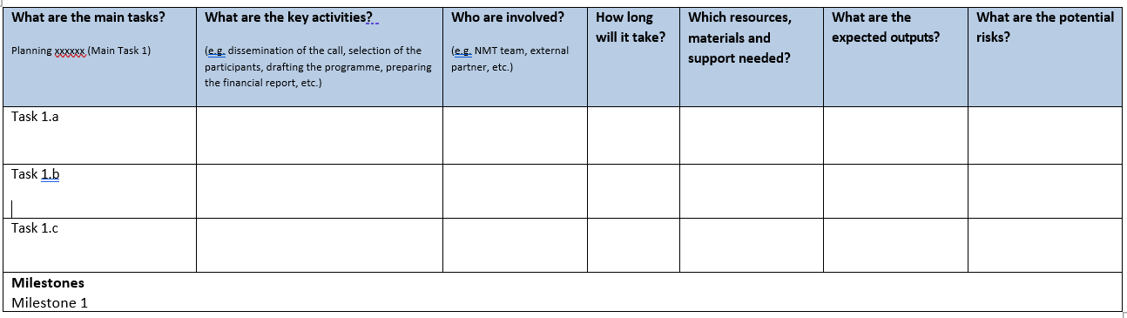
Main Task and Components

Slide 7
Main Task and Component (Sample)
What are the main tasks? Dissemination Materials | What are the key activities? (e.g. dissemination of the call, selection of the participants, drafting the programme, preparing the financial report, etc.) | Who are involved? (e.g. NMT team, external partner, etc.) | How long will it take? | Which resources, materials and support needed? | What are the expected outputs? | What are the potential risks?
Task 1.a “Call for participants” Flyer | Assemble a design team Create flyer designs | Eddy Yusuf, Muhammad Ihsan Zul, PCR Graphics Designer Team | 4 Days | Corel Draw, Proposal, Organization logo | Program flyer | Information is not conveyed properly
Task 1.b ERICA Official Website | Assemble a design team and IT support Create website designs Prepare web hosting | Eddy Yusuf, UPJ IT Team | 4 Days | Domain and hosting, Web IDE Tools, program proposal | Official Website | Website is down and cannot be accessed. Website is not periodically updated
Task 1.c Document preparation and registration link for applicants | Create registration document templates Create online registration form for applicants | Eddy Yusuf, Muhammad Ihsan Zul | 3 Days | Office 365, Google Form | Template for PAP, commitment letter, recommendation letter; registration link is up and running
Milestones Platform and dissemination materials for ERICA is ready

Slide 8
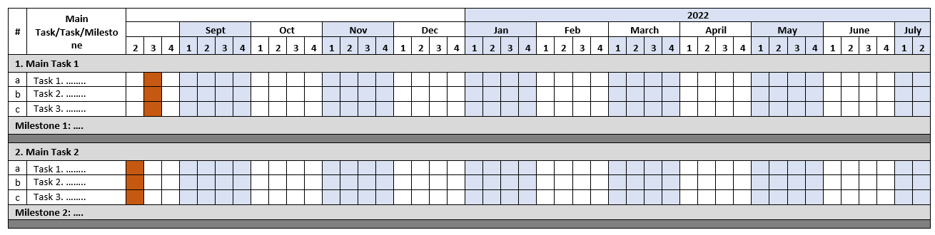
Timeline

Slide 9
Thank You

